Slide 1
Online Retail Store
In this we are working in SQL project of online retail store
Created the database then make the different tables for customers, categories, orders, and order details.
Then inserted the at least 10 records in each table.
After that giving the example of each query.

Slide 2
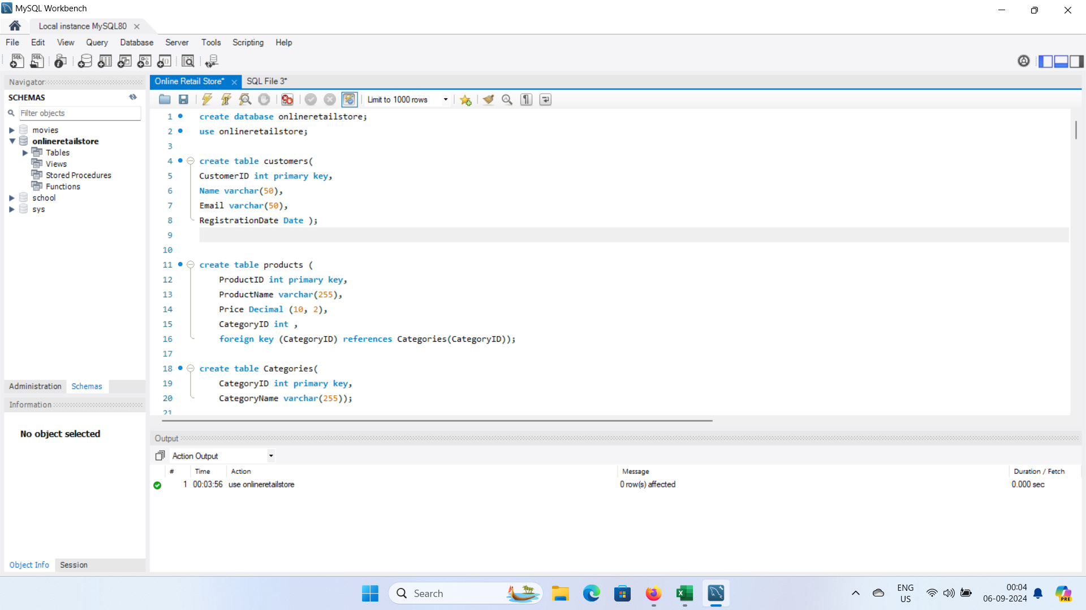

Slide 3
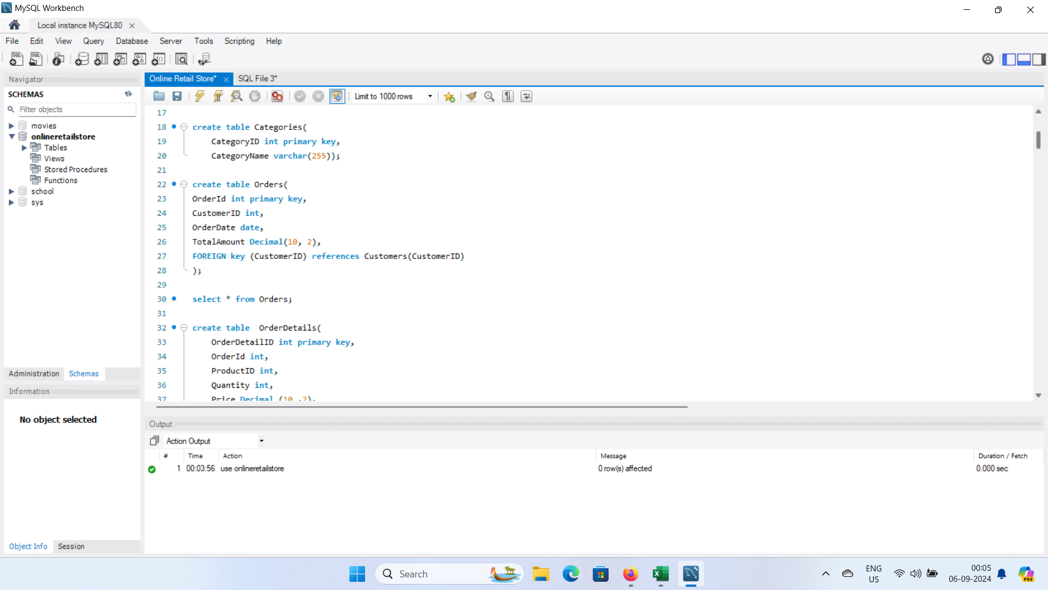

Slide 4
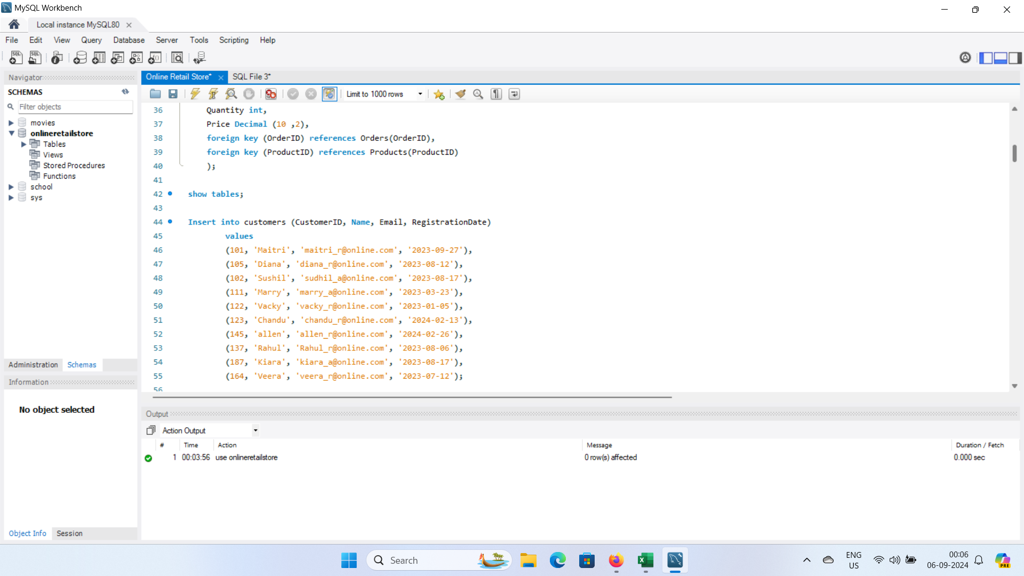

Slide 5
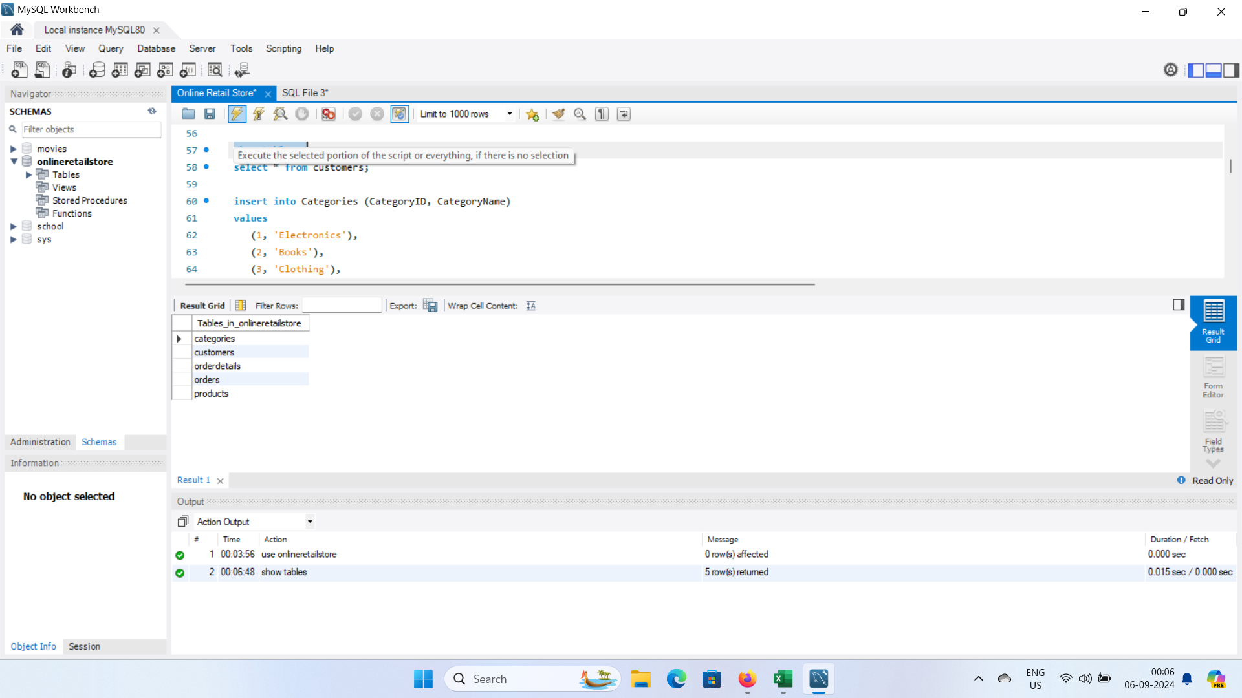

Slide 6
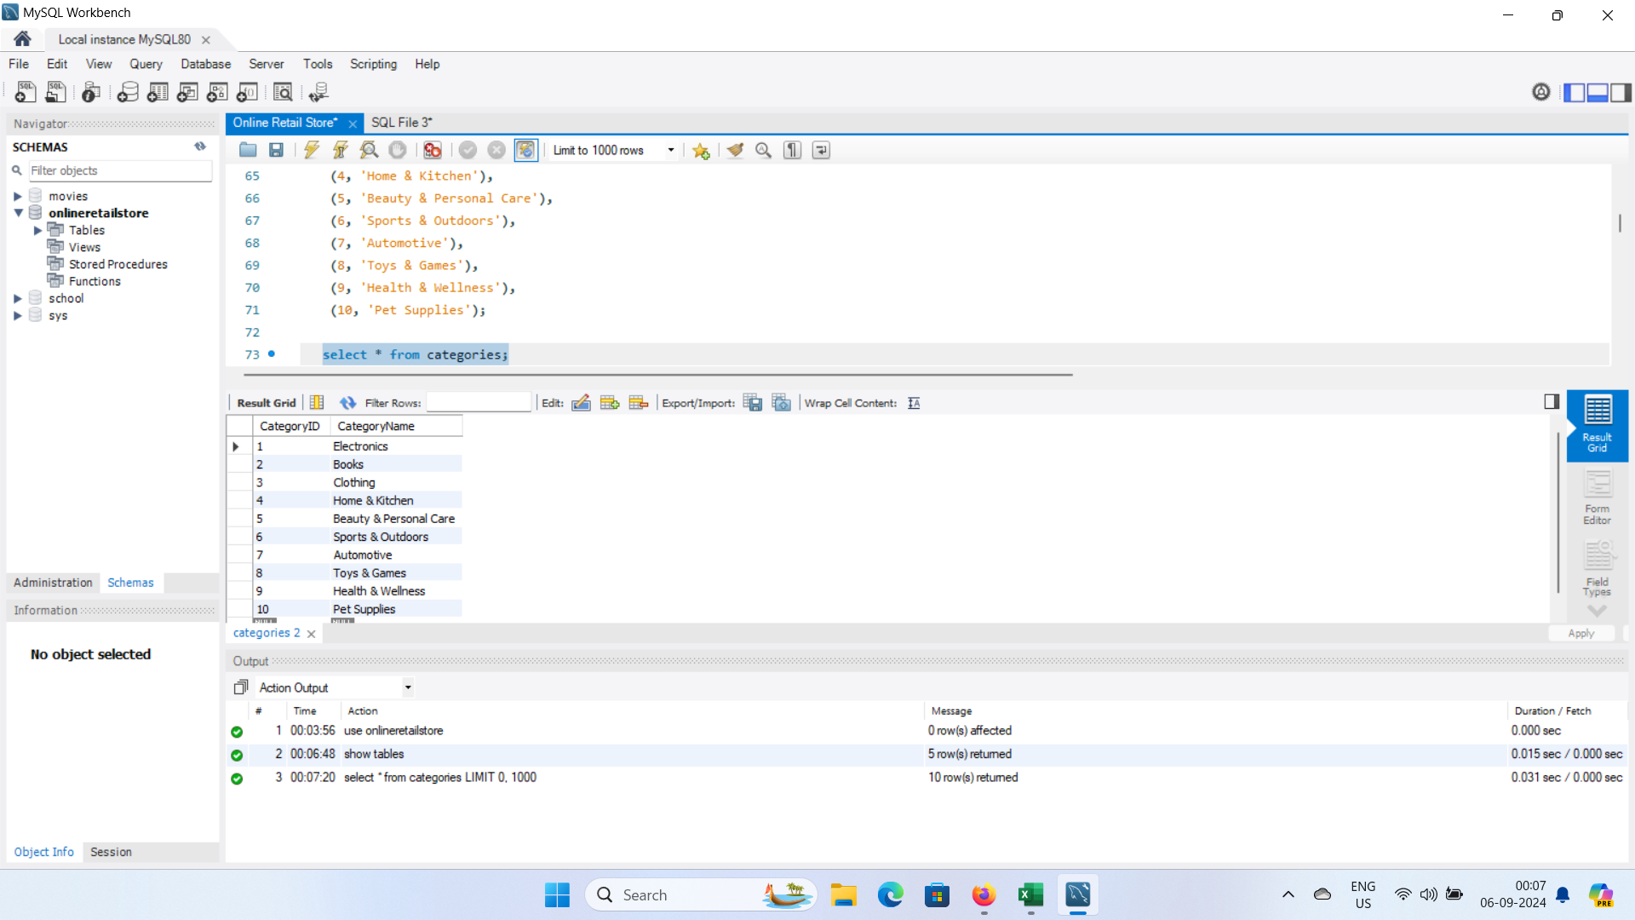

Slide 7
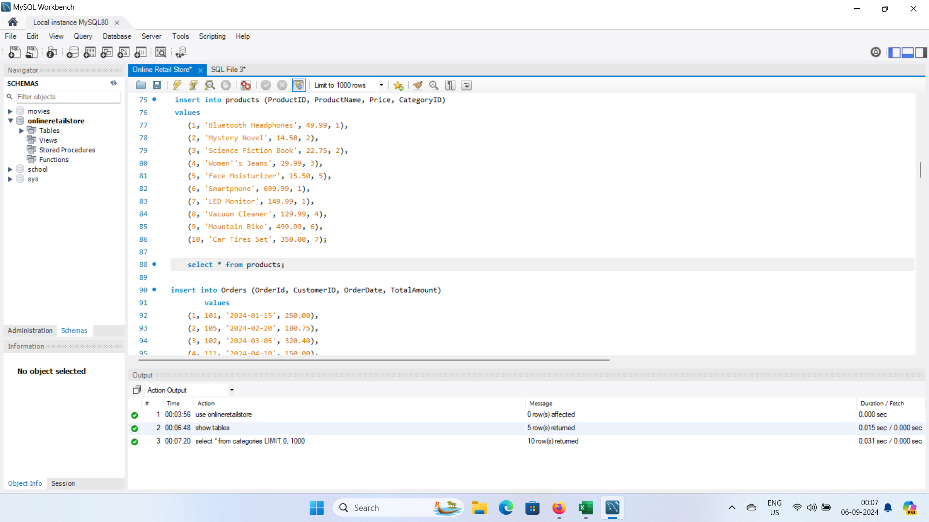

Slide 8
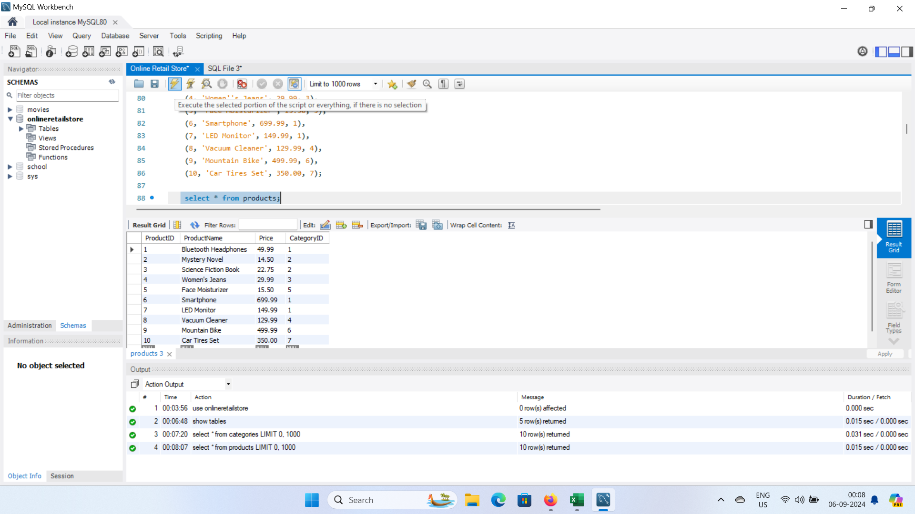

Slide 9
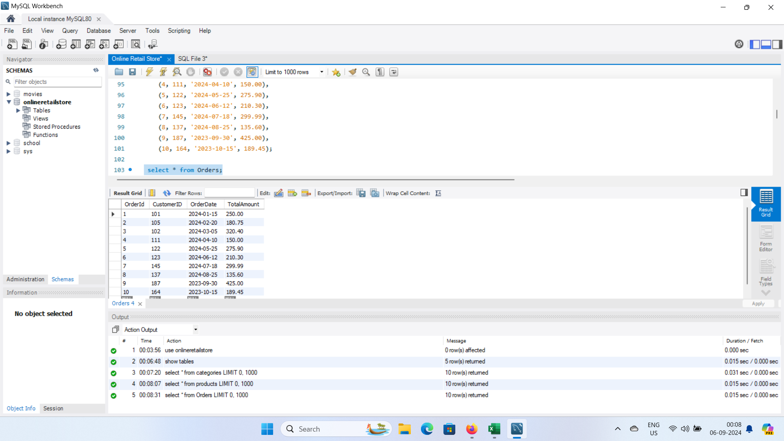

Slide 10
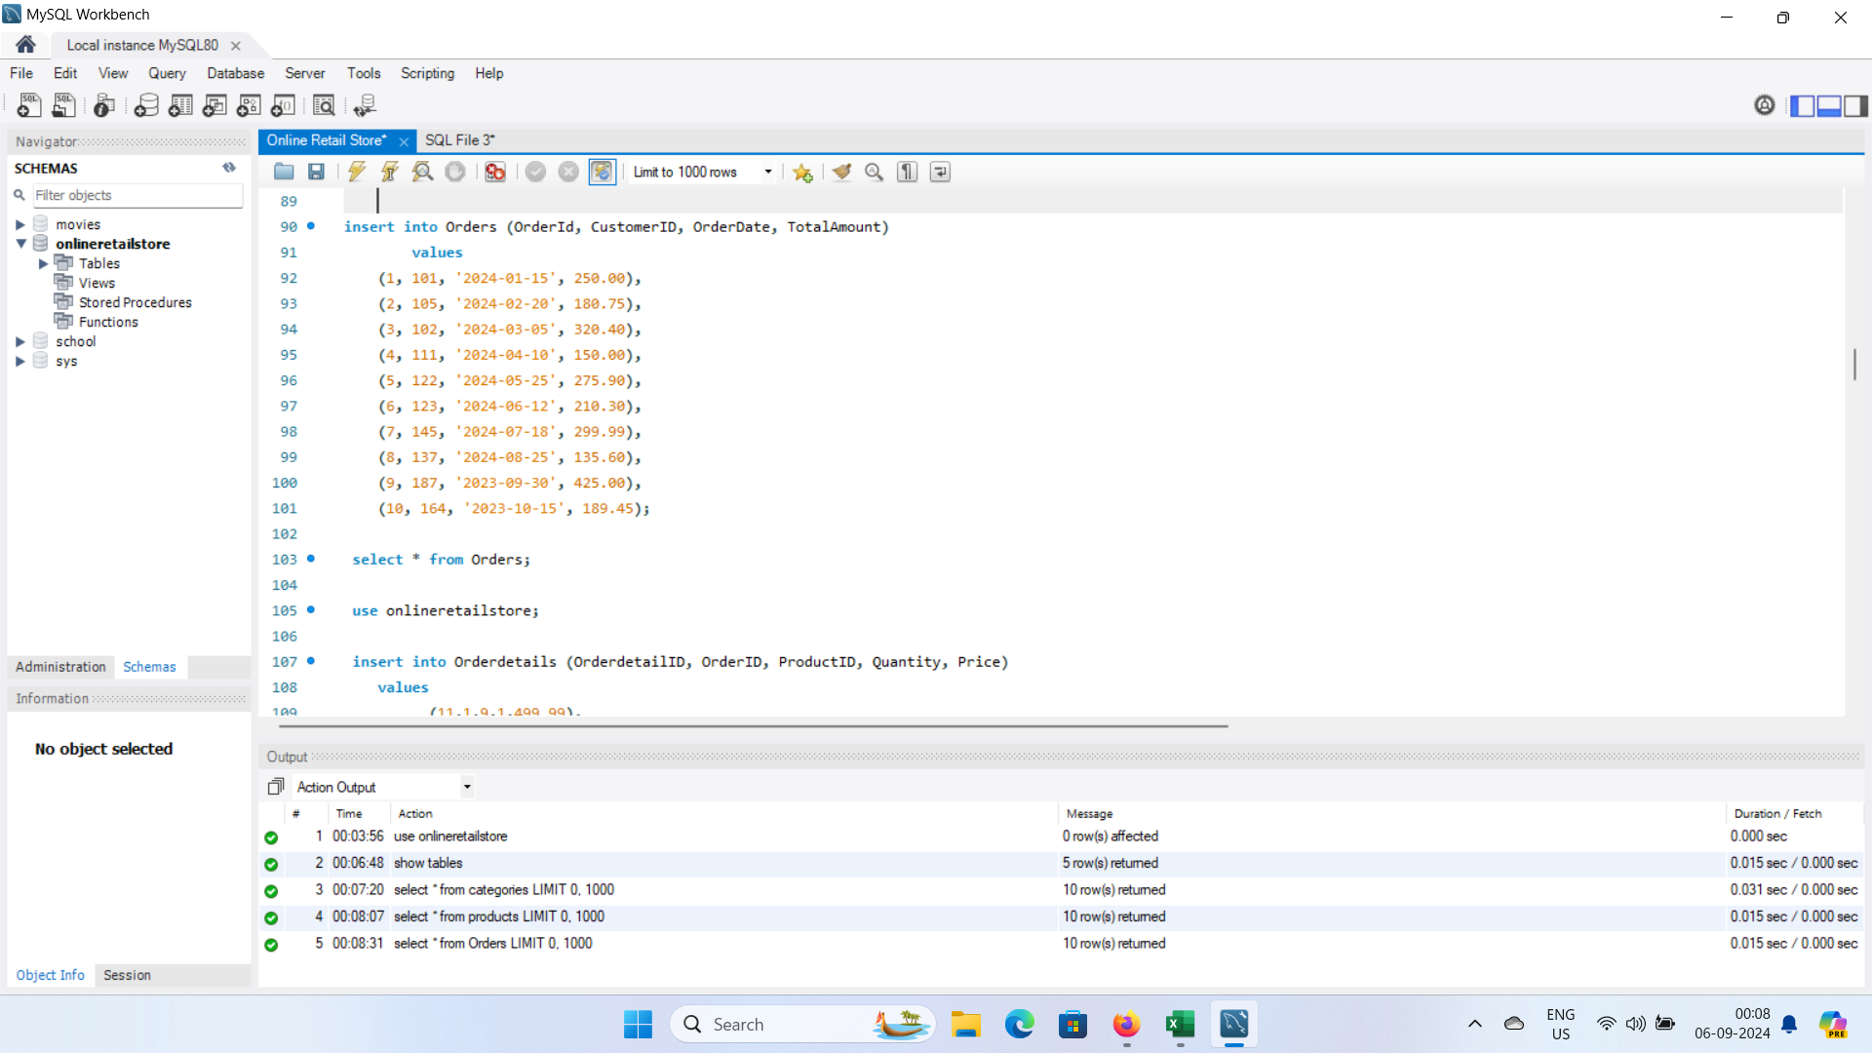

Slide 11
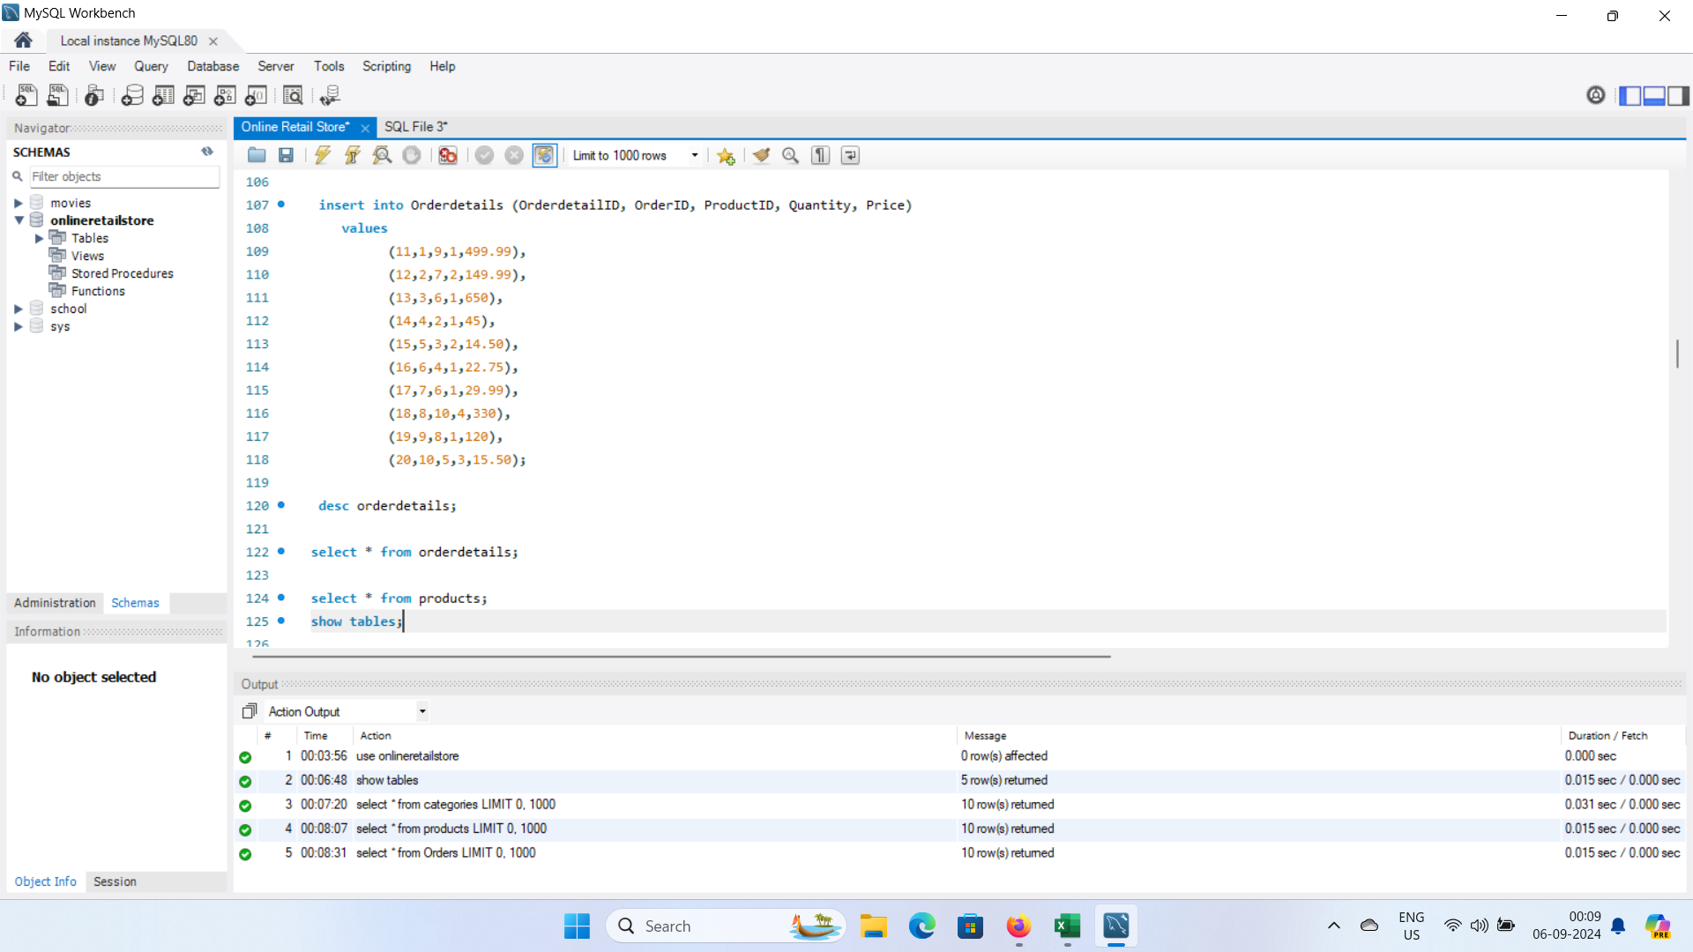

Slide 12
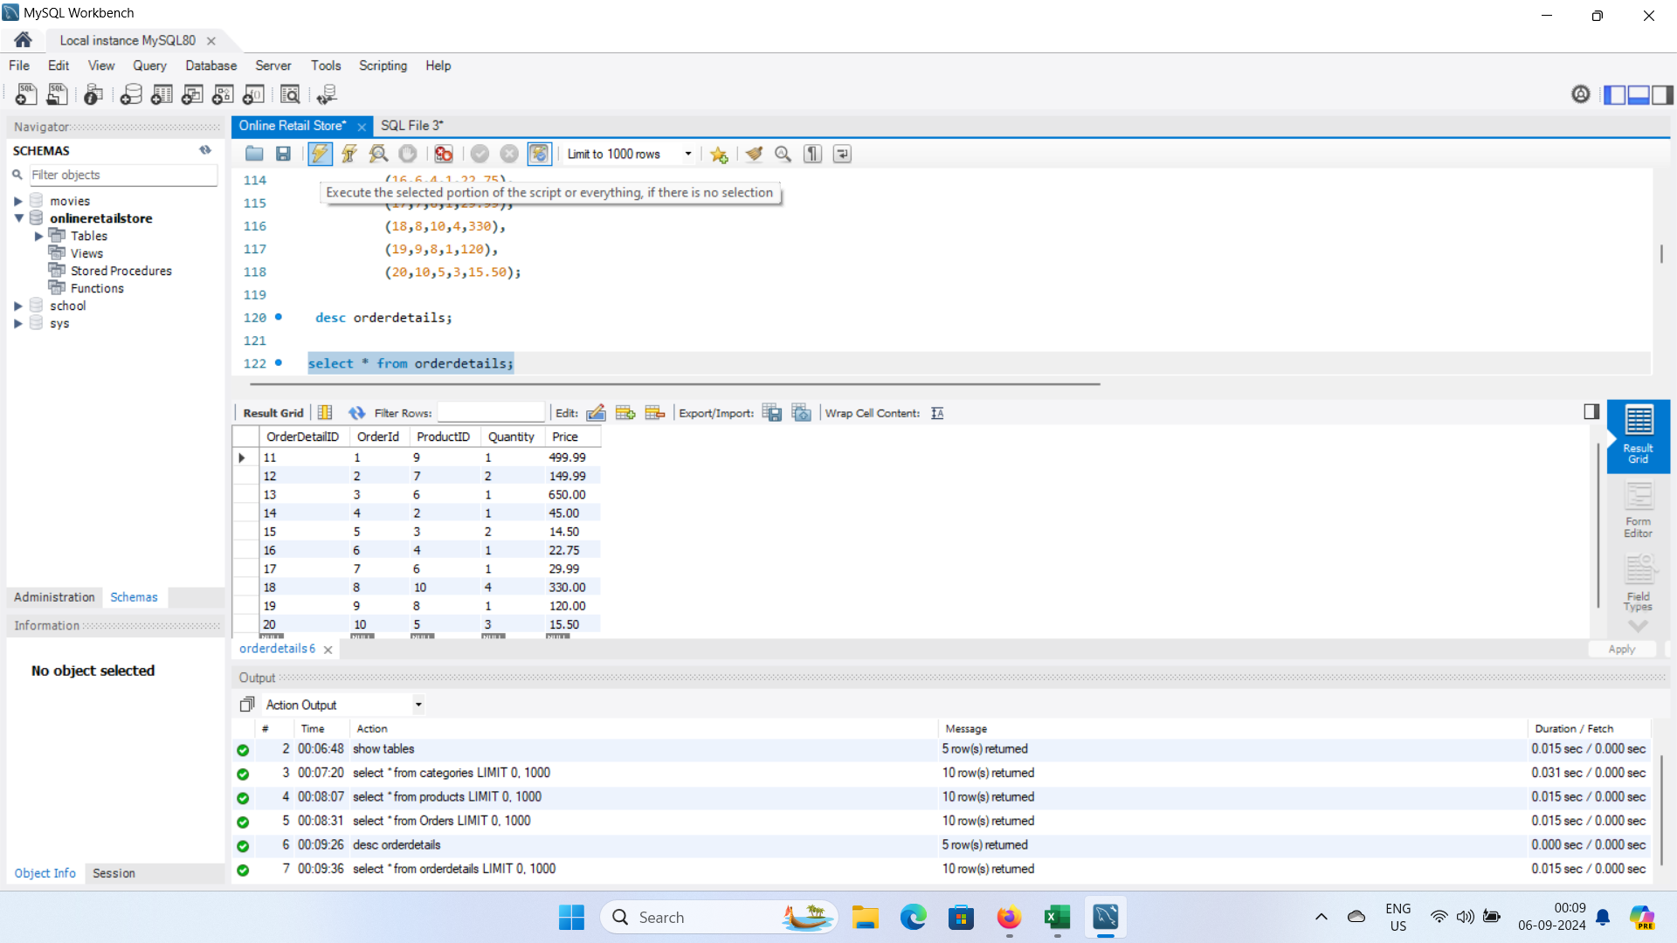

Slide 13
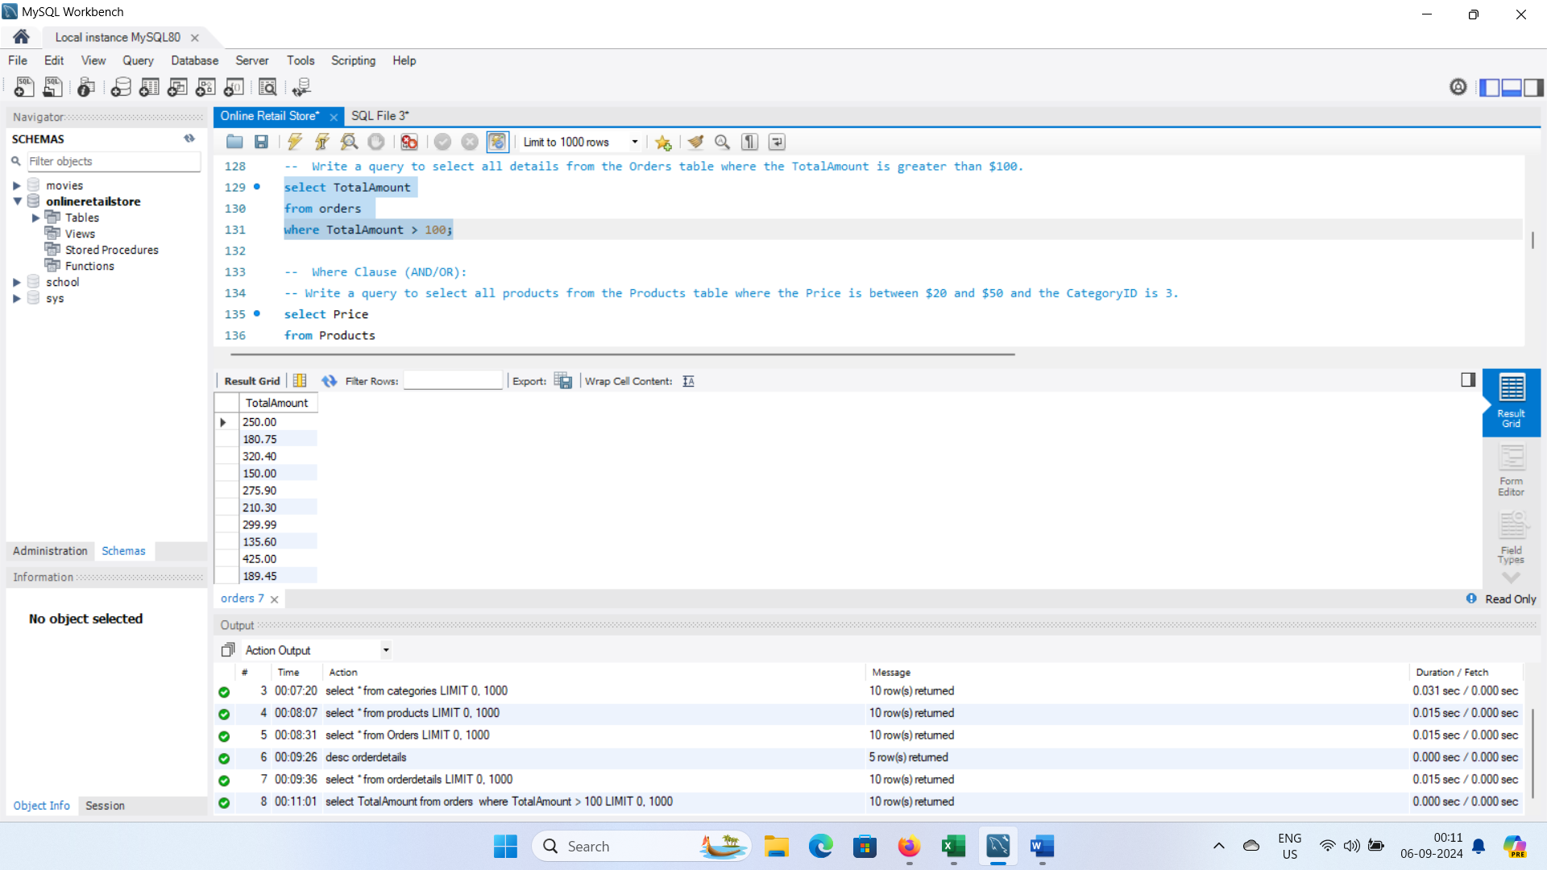

Slide 14
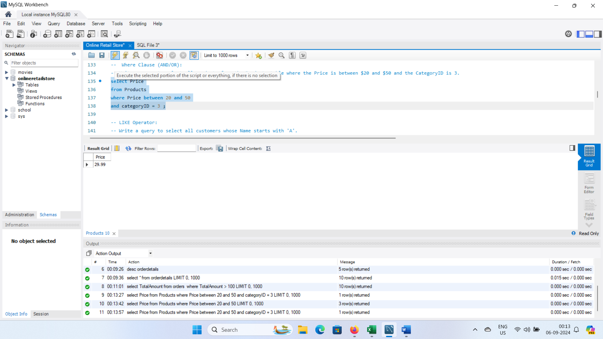
Where Clause (AND/OR)Write a query to select all products from the Products table where the Price is between $20 and $50 and the Category ID is 3.

Slide 15
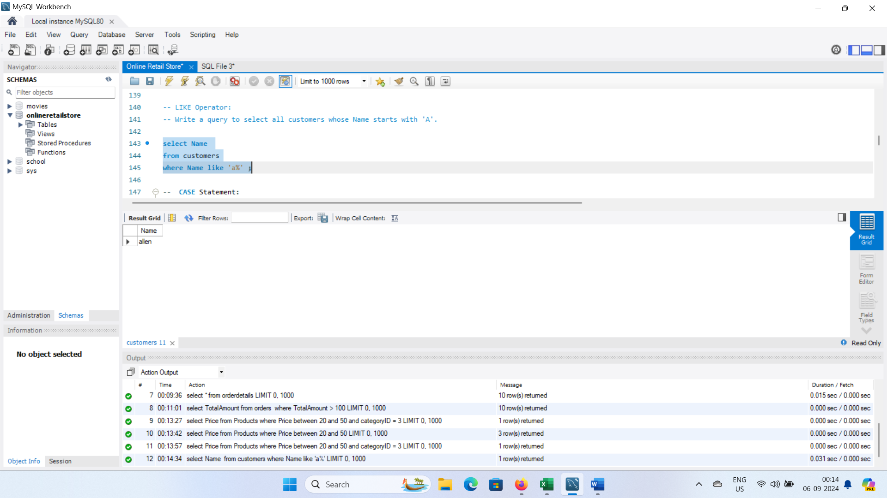
5. LIKE Operator:
Write a query to select all customers whose Name starts with 'A'.

Slide 16
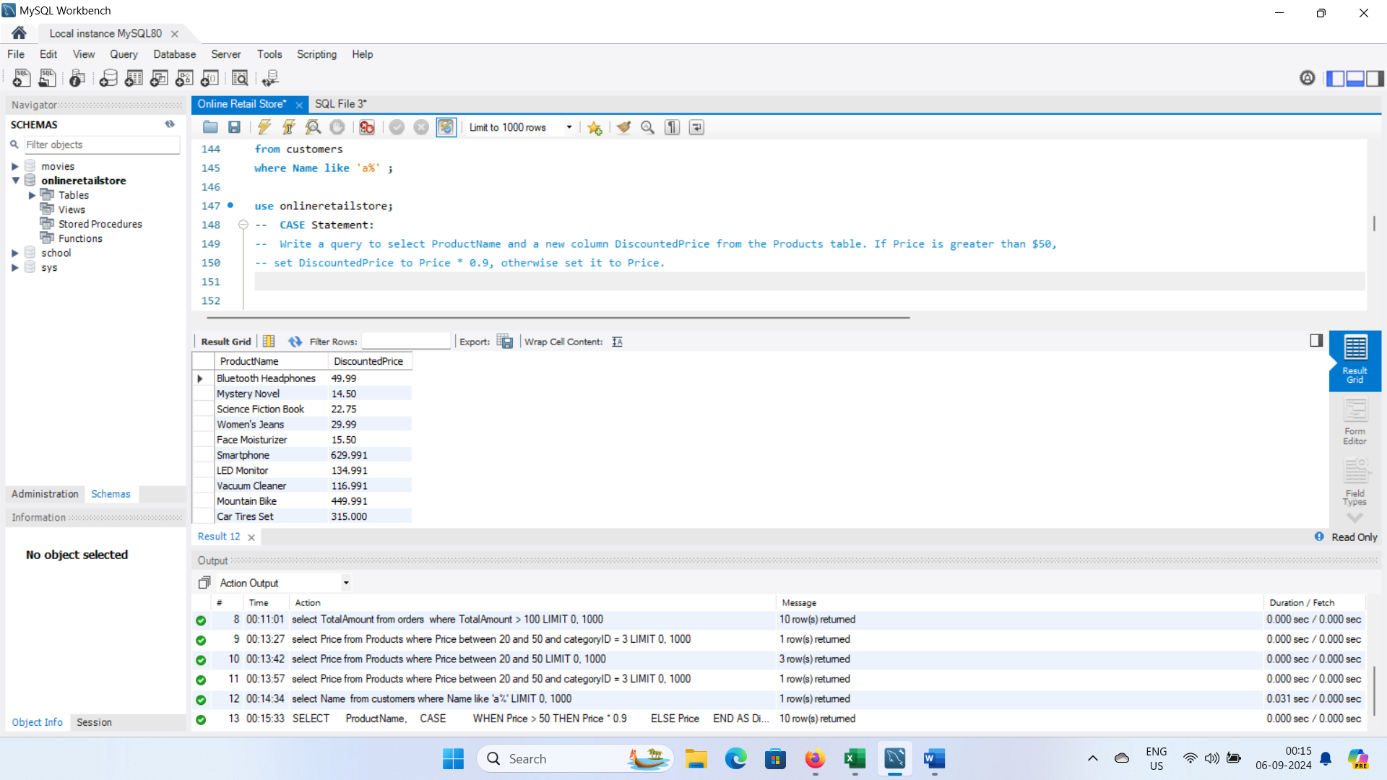
6. CASE Statement:
Write a query to select ProductName and a new column Discounted Price from the Products table. If Price is greater than $50, set Discounted Price to Price * 0.9, otherwise set it to Price.

Slide 17
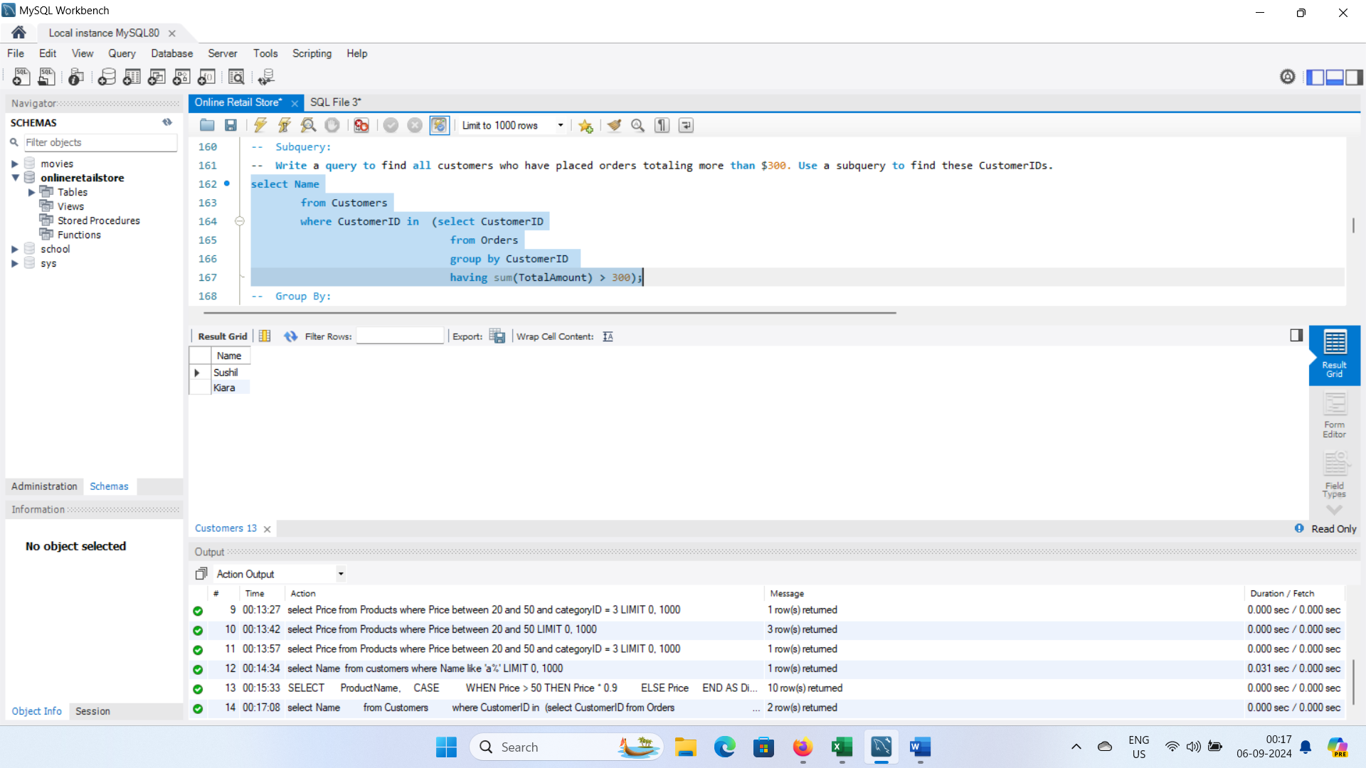
Subquery
Write a query to find all customers who have placed orders totalling more than $500. Use a subquery to find these Customer IDs.
LIKE Operator:
Write a query to select all customers whose Name starts with 'A’.`

Slide 18
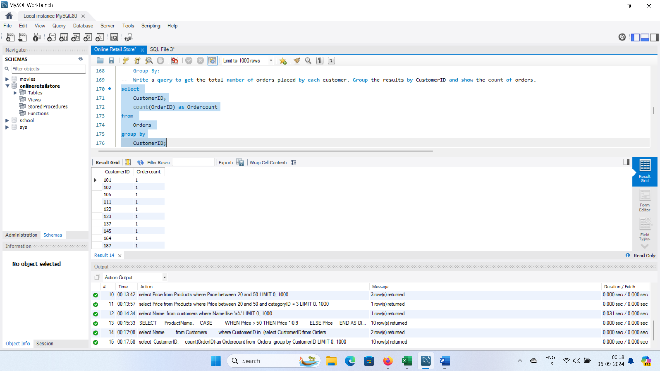
8. Group By:
Write a query to get the total number of orders placed by each customer. Group the results by Customer ID and show the count of orders.

Slide 19
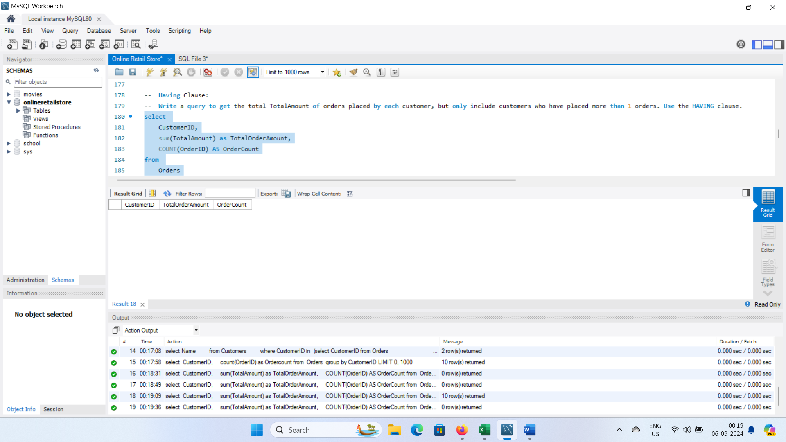
9. Having Clause:
Write a query to get the total Total Amount of orders placed by each customer, but only include customers who have placed more than 2 orders. Use the HAVING clause.

Slide 20
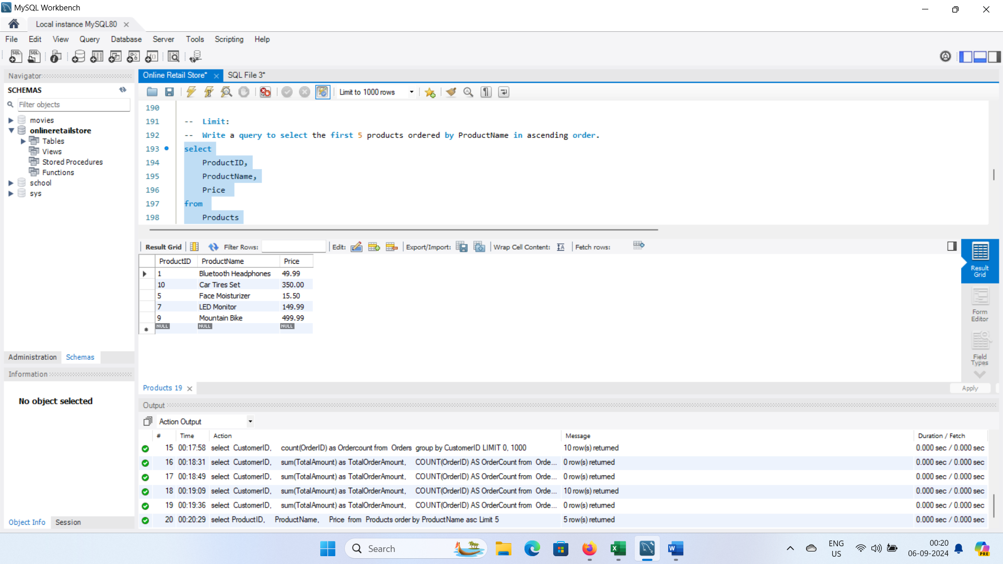
10. Limit:
Write a query to select the first 5 products ordered by ProductName in ascending order.

Slide 21
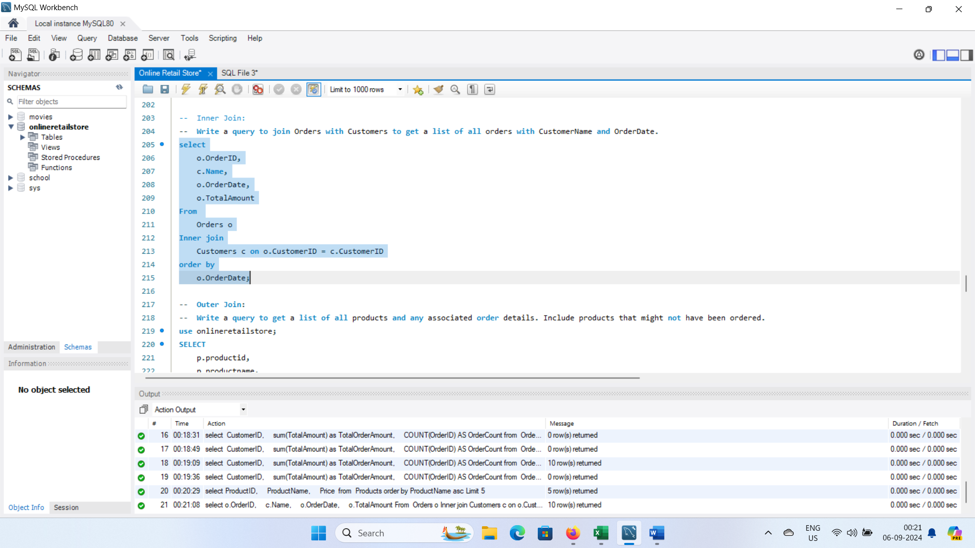
11. Inner Join:
Write a query to join Orders with Customers to get a list of all orders with Customer Name and Order Date.

Slide 22
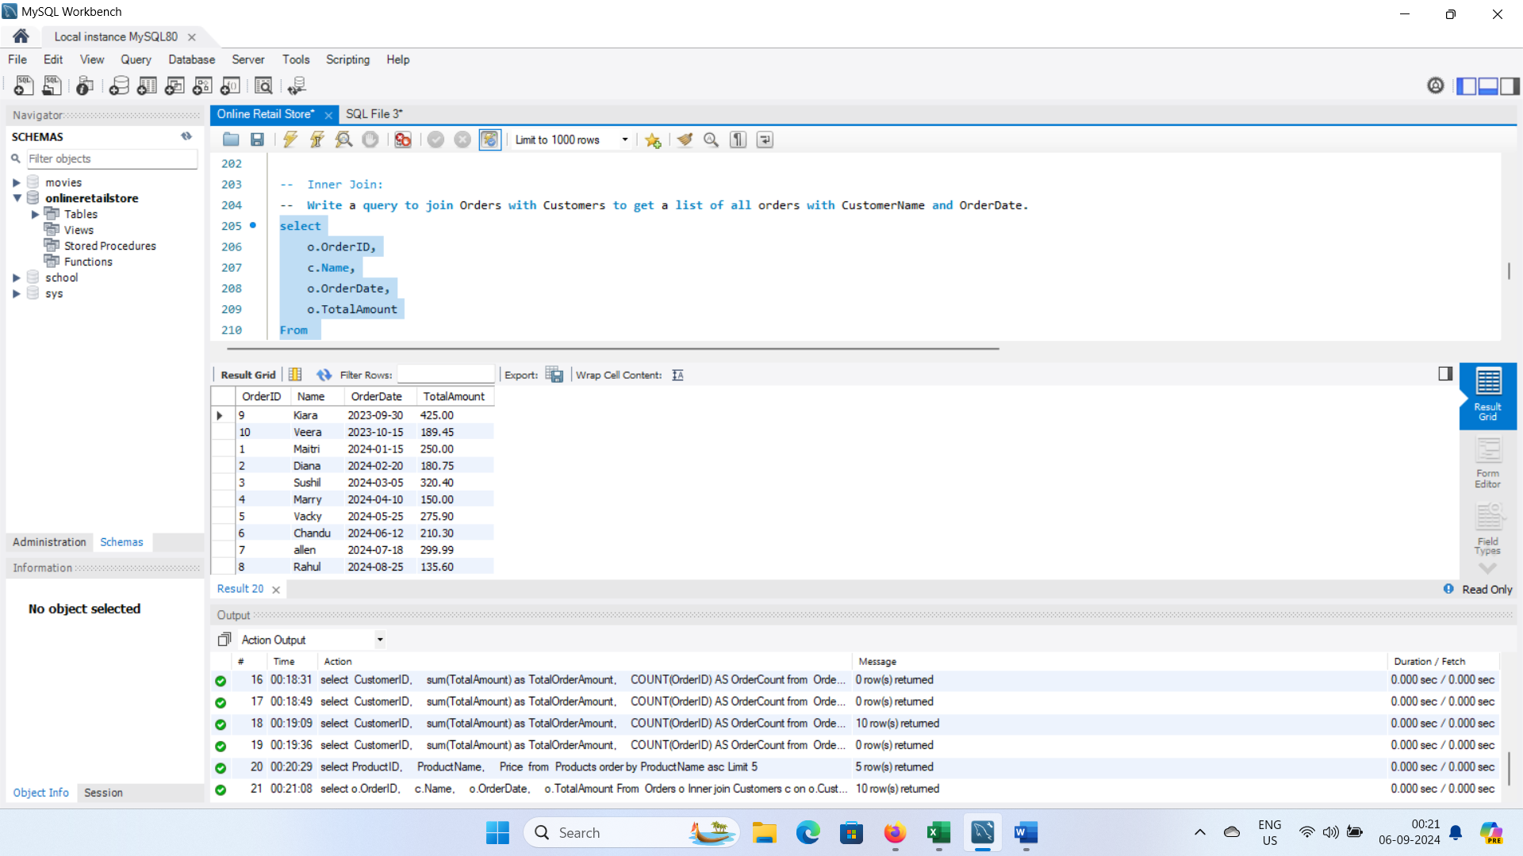

Slide 23
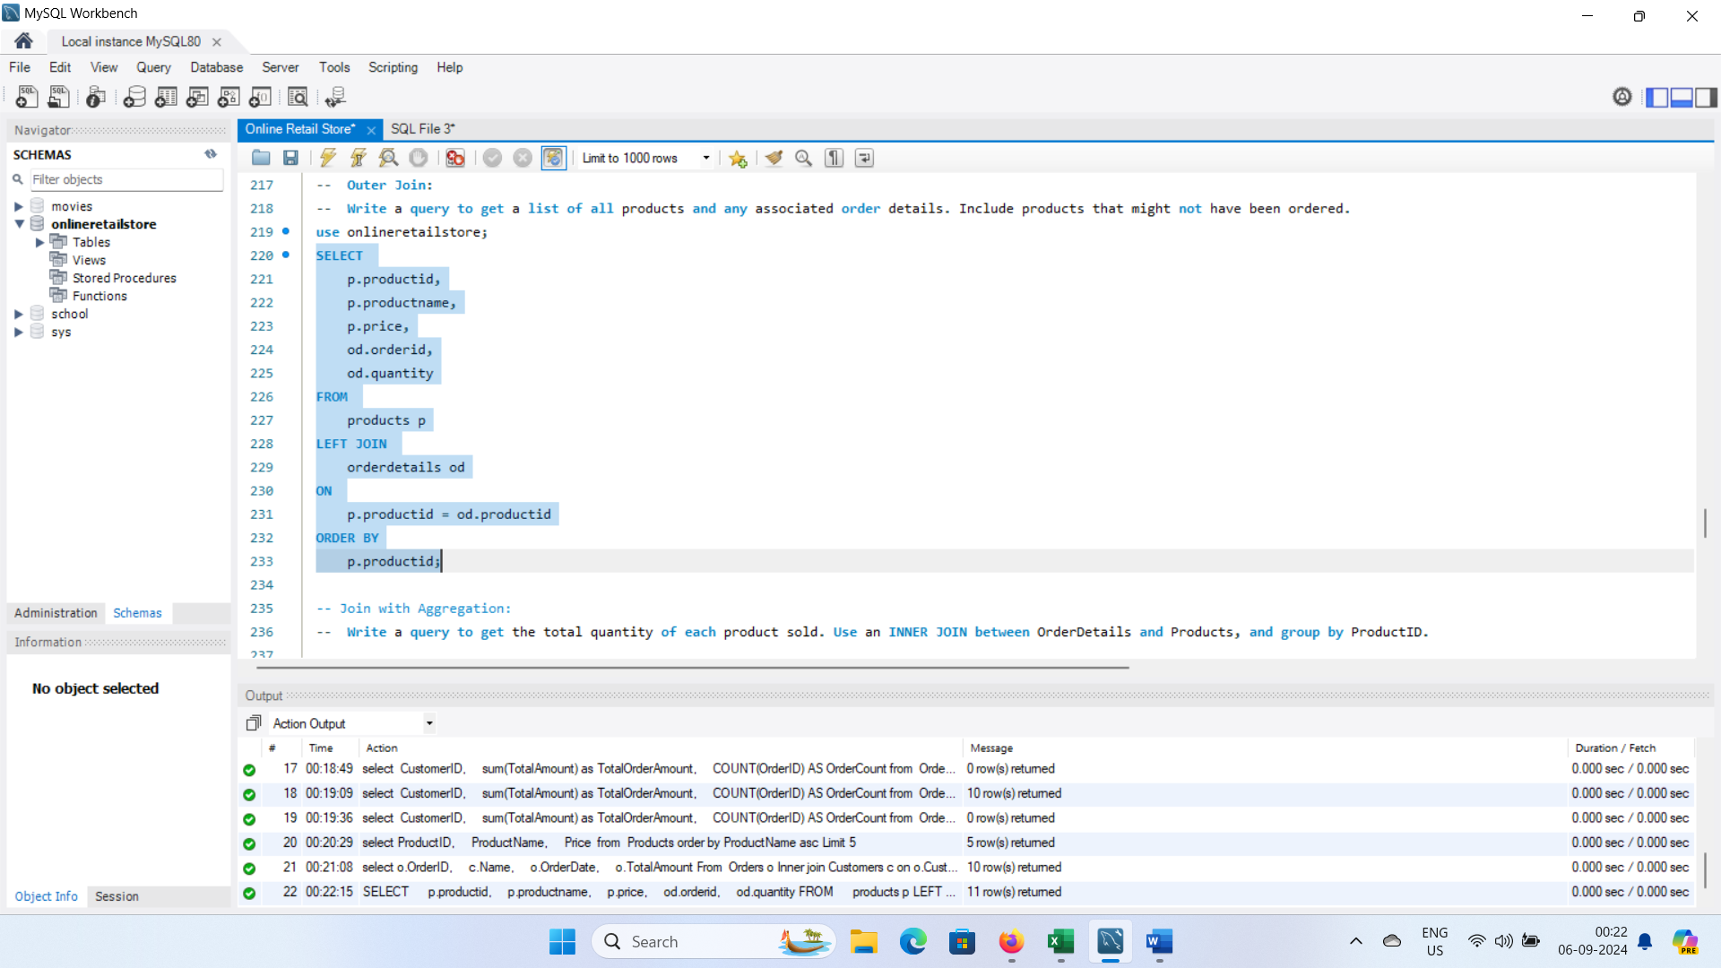
12.Outer Join:
Write a query to get a list of all products and any associated order details. Include products that might not have been ordered

Slide 24
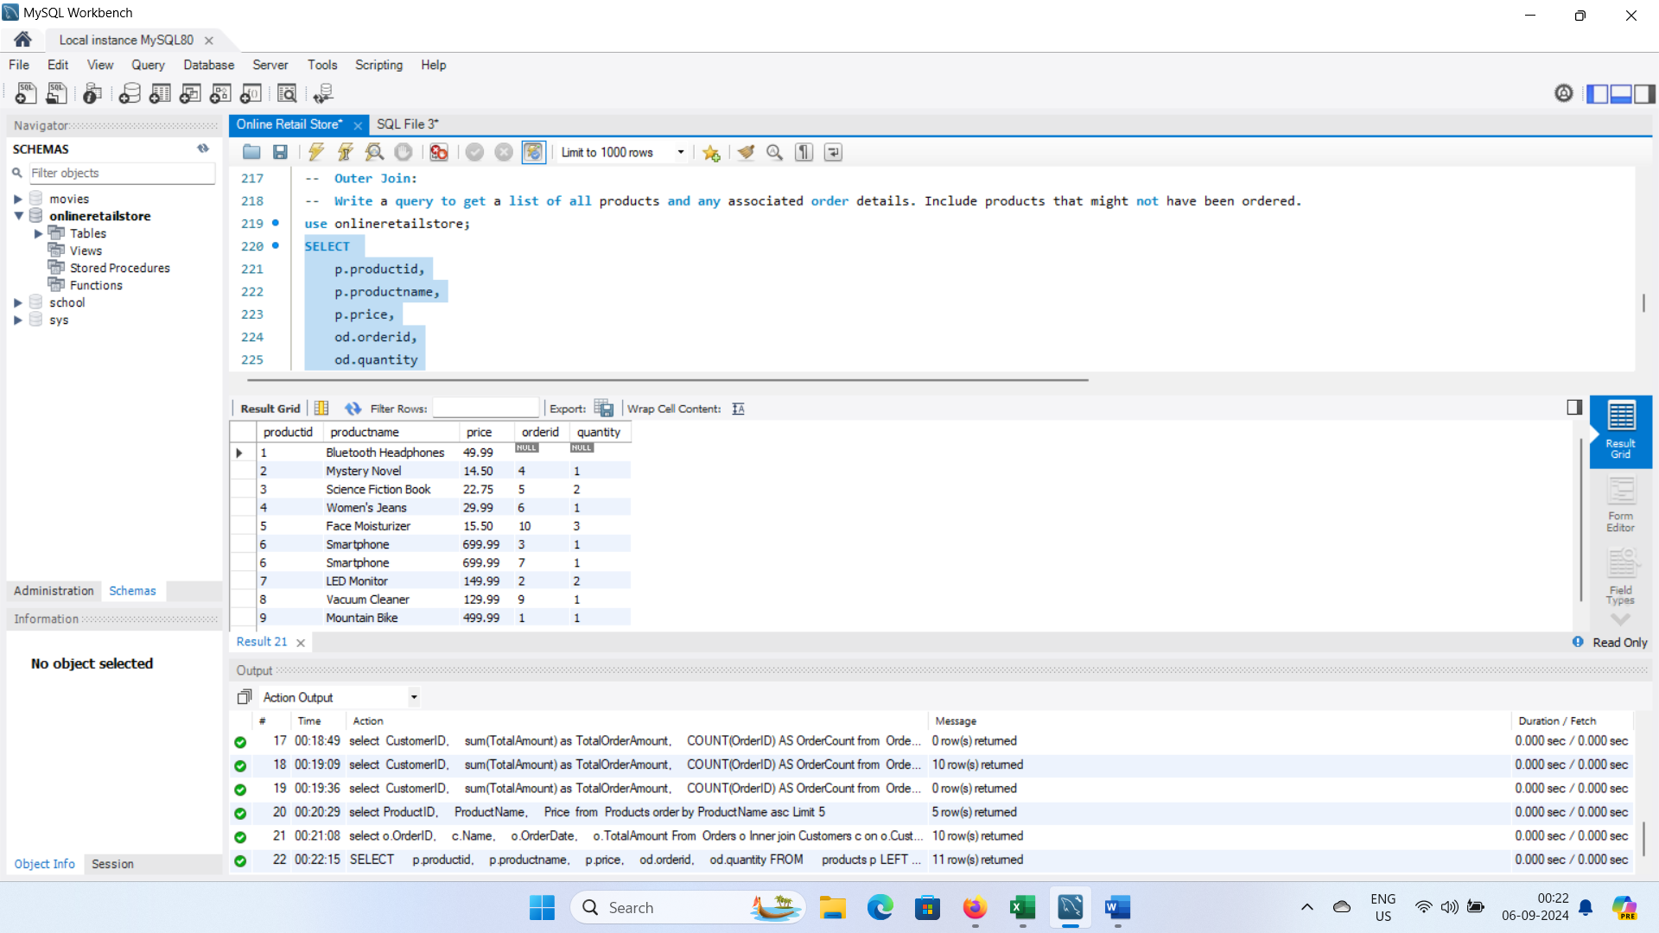

Slide 25
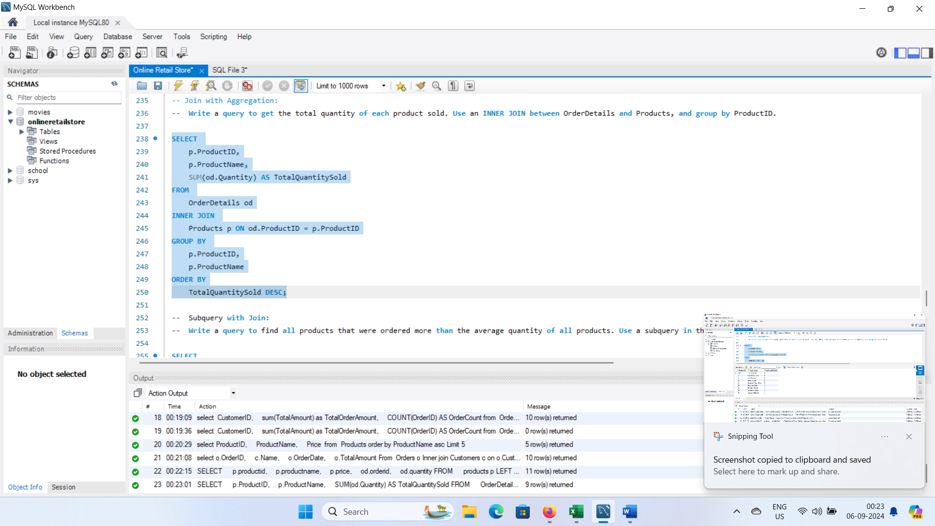
13.Join with Aggregation:
Write a query to get the total quantity of each product sold. Use an INNER JOIN between Order Details and Products, and group by Product ID.

Slide 26
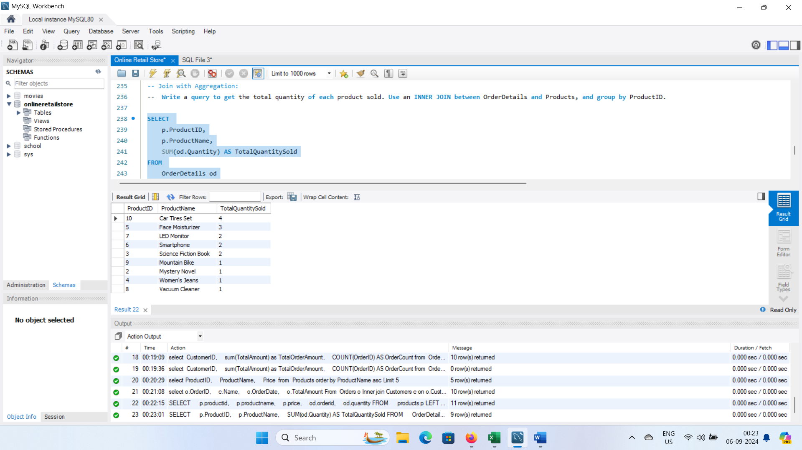

Slide 27
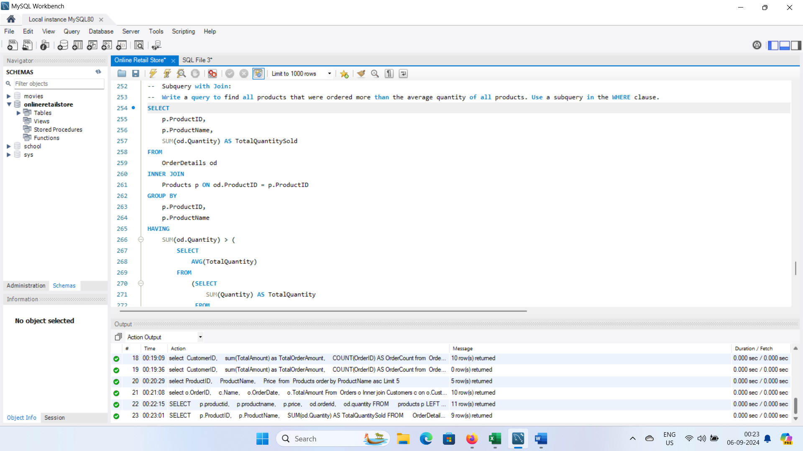
Subquery with Join:
Write a query to find all products that were ordered more than the average quantity of all products. Use a subquery in the WHERE clause.

Slide 28
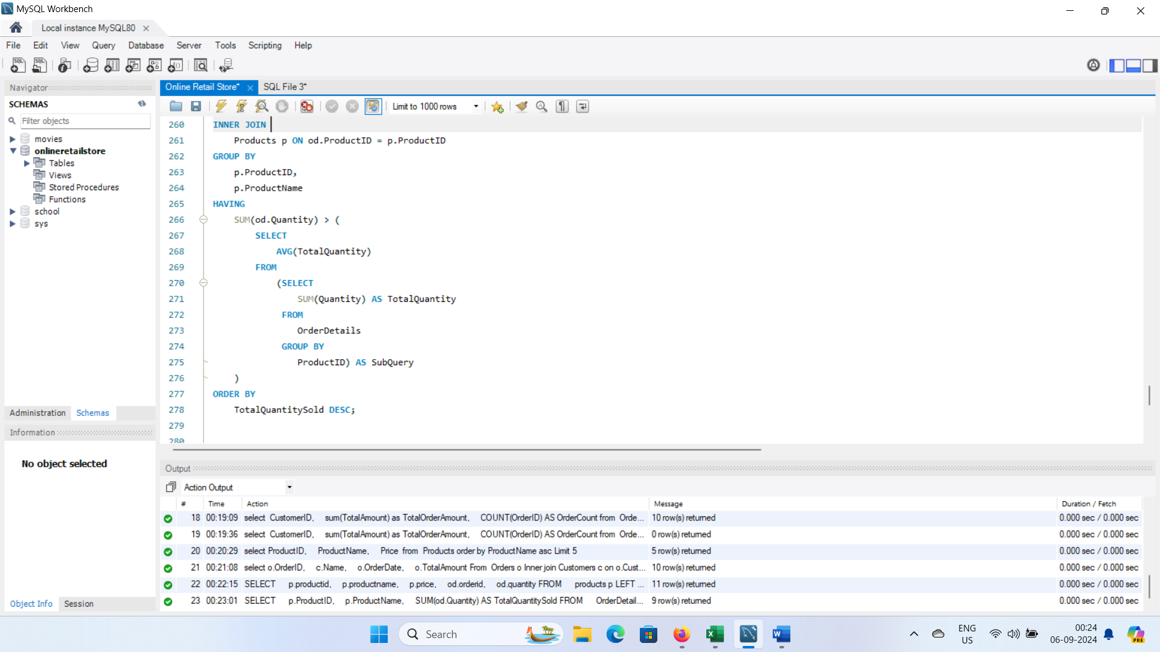

Slide 29
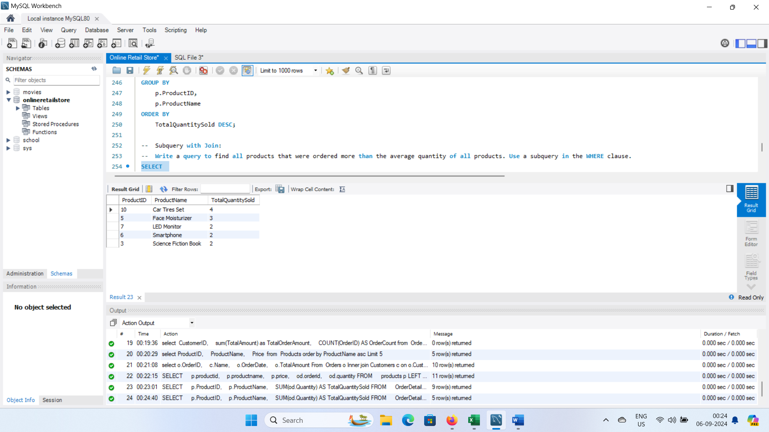

Slide 30
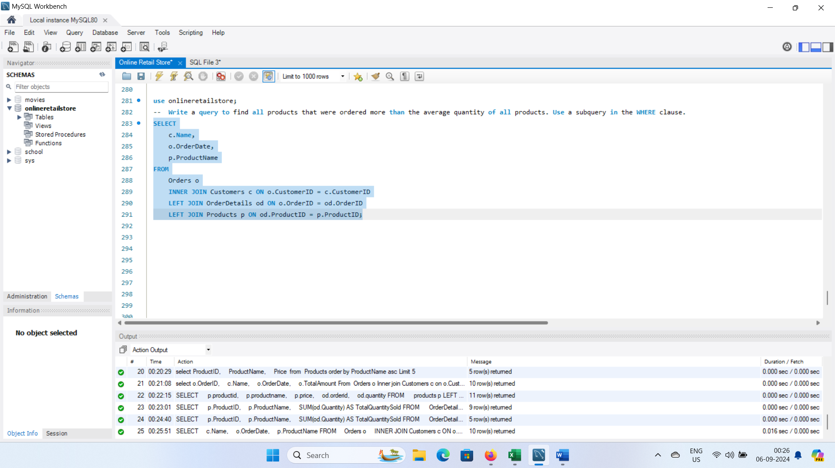
Advanced Join:
Write a query to list Customer Name, Order Date, and ProductName for all orders. Use INNER JOIN and LEFT JOIN if necessary to get all required details.

Slide 31
